Slide 1

ALGEBRA
Math 10-3

Slide 2
LESSON 4
RATIONAL EXPONENTS , and RADICALS

Slide 3
RATIONAL EXPONENTS AND RADICALS
To this point, the expression b^{n} has been defined for real numbers b and integers n. Now we wish to extend the definition of exponents to include rational numbers so that expressions such as 2^{1/2} will be meaningful.
Not just any definition will do. We want a definition of rational exponents for which the properties of integer exponents are true.
The following example shows the direction we can take to accomplish our goal.

Slide 4
RATIONAL EXPONENTS AND RADICALS
If the product property for exponential expressions is to hold for rational exponents, then for rational numbers p and q, b^{p}b^{q} = b^{p + q}.
For example,
9^{1/2}  9^{1/2} must equal 9^{1/2 + 1/2} = 9¹ = 9
Thus 9^{1/2} must be a square root of 9. That is, 9^{1/2} = 3.
The example suggests that b^{1/n} can be defined in terms of roots according to the following definition.

Slide 5
RATIONAL EXPONENTS AND RADICALS
Definition of b^{1/n}
If n is an even positive integer and b ≥ 0, then b^{1/n} is the nonnegative real number such that (b^{1/n})^{n} = b.
If n is an odd positive integer, then b^{1/n} is the real number such that (b^{1/n})^{n} = b.
EXAMPLE
25^{1/2} = 5 because 5² = 25.
(–64)^{1/3} = – 4 because (– 4)³ = –64.
16^{1/2} = 4 because 4² = 16.

Slide 6
RATIONAL EXPONENTS AND RADICALS
–16^{1/2} = –(16^{1/2}) = – 4.
(–16)^{1/2} is not a real number.
(–32)^{1/5} = –2 because (–2)⁵ = –32.
If n is an even positive integer and b < 0, then b^{1/n} is a complex number.

Slide 7
RATIONAL EXPONENTS AND RADICALS
To define expressions such as 8^{2/3}, we will extend our definition of exponents even further.
Because we want the power property (b^{p})^{q} = b^{pq} to be true for rational exponents also, we must have (b^{1/n})^{m} = b^{m/n}. With this in mind, we make the following definition.
Definition of b^{m/n}
For all positive integers m and n such that m/n is in simplest form, and for all real numbers b for which b^{1/n} is a real number,
b^{m/n} = (b^{1/n})^{m} = (b^{m})^{1/n}

Slide 8
RATIONAL EXPONENTS AND RADICALS
Because b^{m/n} is defined as (b^{1/n})^{m} and as (b^{m})^{1/n}, we can evaluate expressions such as 8^{4/3} in more than one way.
For example, because 8^{1/3} is a real number, 8^{4/3} can be evaluated in either of the following ways.
8^{4/3} = (8^{1/3})⁴ = 2⁴ =16
8^{4/3} = (8⁴)^{1/3} = 4096^{1/3} =16
Of the two methods, the b^{m/n} = (b^{1/n})^{m} method is usually easier to apply, provided you can evaluate b^{1/n}.

Slide 9
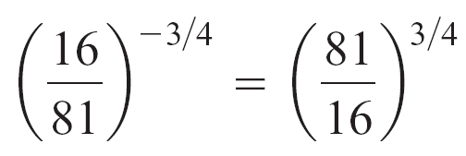
EVALUATE A NUMBER WITH A RATIONAL EXPONENT
EXAMPLE
Simplify.
a. 64^{2/3} b. 32^{–3/5} c.
Solution:
a. 64^{2/3} = (64^{1/3})²
b. 32^{–3/5} = (32^{1/5})^{–3}
c.
= 4²
= 16
= 2^{–3}

Slide 10
RATIONAL EXPONENTS AND RADICALS
Properties of Rational Exponents
If p, q, and r represent rational numbers and a and b are positive real numbers, then
Product b^{p}  b^{q} = b^{p + q}
Quotient = b^{p – q}
Power (b^{p})^{q} = b^{pq} (a^{p}b^{q})^{r} = a^{pr}b^{qr}

Slide 11
RATIONAL EXPONENTS AND RADICALS
Recall that an exponential expression is in simplest form
when no powers of powers or negative exponents occur
and each base occurs at most once.

Slide 12



SIMPLIFYING RADICAL EXPRESSIONS
Radicals, expressed by the notation , are also used to
denote roots. The number b is the radicand, and the
positive integer n is the index of the radical.
Definition of
If n is a positive integer and b is a real number such that
b^{1/n} is a real number, then
If the index n equals 2, then the radical is written as
simply , and it is referred to as the principal square
root of b, or simply the square root of b.

Slide 13


SIMPLIFYING RADICAL EXPRESSIONS
The symbol is reserved to represent the nonnegative
square root of b. To represent the negative square root of
b, write For example, = 5, whereas
= –5.
Definition of
For all positive integers n, all integers m, and all real
numbers b such that is a real number,

Slide 14
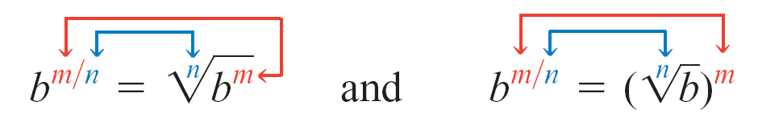
SIMPLIFYING RADICAL EXPRESSIONS
When is a real number, the equations
can be used to write exponential expressions such as b^{m/n} in radical form.
Use the denominator n as the index of the radical and the numerator m as the power of the radicand or as the power of the radical.

Slide 15
SIMPLIFYING RADICAL EXPRESSIONS
EXAMPLE
The equations
and
also can be used to write radical expressions in exponential form.
Use the denominator 3 as the index
of the radical and the numerator 2
as the power of the radical.
EXAMPLE
Use the index 2 as the denominator
of the power and the exponent 3 as
the numerator of the power.

Slide 16
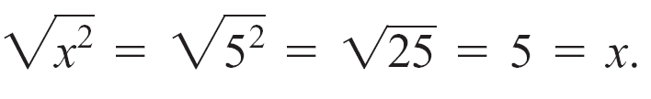
SIMPLIFYING RADICAL EXPRESSIONS
The definition of often can be used to evaluate
radical expressions. For instance,
= 8^{4/3} = (8^{1/3})⁴ = 2⁴ = 16
Consider when x = 5 and when x = –5.
Case 1: If x = 5, then
Case 2: If x = –5, then

Slide 17
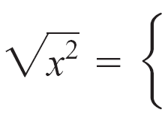
SIMPLIFYING RADICAL EXPRESSIONS
These two cases suggest that
x, if x ≥ 0
–x, if x < 0
Recalling the definition of absolute value, we can write this
more compactly as

Slide 18


SIMPLIFYING RADICAL EXPRESSIONS
Simplifying odd roots of a variable expression does not
require using the absolute value symbol. Consider
when x = 5 and when x = –5.
Case 1: If x = 5, then
Case 2: If x = –5, then
Thus

Slide 19

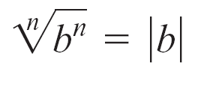
SIMPLIFYING RADICAL EXPRESSIONS
Although we have illustrated this principle only for square roots and cube roots, the same reasoning can be applied to other cases. The general result is given below.
Definition of
If n is an even natural number and b is a real number, then
If n is an odd natural number and b is a real number, then

Slide 20
SIMPLIFYING RADICAL EXPRESSIONS
EXAMPLE
Because radicals are defined in terms of rational powers, the properties of radicals are similar to those of exponential expressions.

Slide 21
SIMPLIFYING RADICAL EXPRESSIONS
Properties of Radicals
If m and n are natural numbers and a and b are positive real numbers, then
Product
Quotient
Index

Slide 22

SIMPLIFYING RADICAL EXPRESSIONS
A radical is in simplest form if it meets all of the following criteria.
1. The radicand contains only powers less than the index.
( does not satisfy this requirement because 5, the
exponent, is greater than 2, the index.)
2. The index of the radical is as small as possible.
( does not satisfy this requirement because
)

Slide 23
SIMPLIFYING RADICAL EXPRESSIONS
3. The denominator has been rationalized. That is, no
radicals occur in the denominator. ( does not
satisfy this requirement.)
4. No fractions occur under the radical sign. ( does
not satisfy this requirement.)
Radical expressions are simplified by using the properties of radicals.

Slide 24

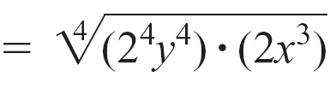

SIMPLIFY RADICAL EXPRESSIONS
EXAMPLE
Simplify.
a. b.
Solution:
a.
Factor and group factors that can be written as a power of the index.
Use the product property of radicals.
Recall that for n even,

Slide 25




SIMPLIFY RADICAL EXPRESSIONS
cont’d
Factor and group factors that can be written as a power of the index.
b.
Use the product property of
radicals.
Recall that for n odd,

Slide 26
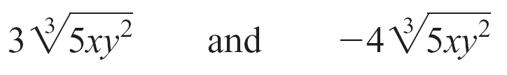
SIMPLIFYING RADICAL EXPRESSIONS
Like radicals have the same radicand and the same index. For instance,
are like radicals.
Addition and subtraction of like radicals are accomplished by using the distributive property. For example,

Slide 27

SIMPLIFYING RADICAL EXPRESSIONS
The sum cannot be simplified further because
the radicands are not the same.
The sum cannot be simplified because the
indices are not the same.
Sometimes it is possible to simplify radical expressions that do not appear to be like radicals by simplifying each radical expression.

Slide 28

SIMPLIFY ING RADICAL EXPRESSIONS
Multiplication of radical expressions is accomplished by using the distributive property. For instance,
Finding the product of more complicated radical expressions may require repeated use of the distributive property.
Use the distributive
property.
Multiply the radicals.
Simplify.

Slide 29

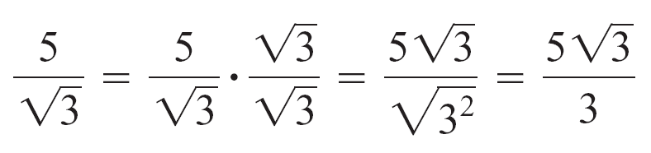
SIMPLIFYING RADICAL EXPRESSIONS
To rationalize the denominator of a fraction means to write the fraction in an equivalent form that does not involve any radicals in the denominator.
This is accomplished by multiplying the numerator and denominator of the radical expression by an expression that will cause the radicand in the denominator to be a perfect root of the index.
Recall that means
Multiply numerator and
denominator by so that the
radicand is a perfect root of the index of the radical.

Slide 30
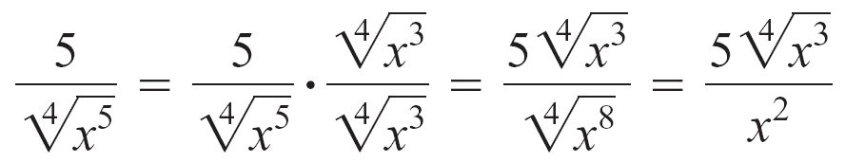
SIMPLIFYING RADICAL EXPRESSIONS
Multiply numerator and
denominator by
so that the radicand
is a perfect root of the
index of the radical.
Multiply numerator and
denominator by
so that the radicand
is a perfect root of the
index of the radical.

Slide 31


SIMPLIFYING RADICAL EXPRESSIONS
To rationalize the denominator of a fractional expression such as
we use the conjugate , of which is
The product of these conjugate pairs does not involve a radical.

